Slide 1
Exploring Deep Learning Models for Sentiment Classification in Customer Reviews

Slide 2
Presented By
Kazi Habibur Rahaman
ID: 20101559
Group: 08
Research Assistant:
Ehsanur Rahman Rhythm
Student Tutor:
Farah Binta Haque

Slide 3
Abstract
Reviews are crucial in the field of tourism as they serve as a guide for travelers. Sentiment analysis plays a vital role in this case. Sentiment analysis is vital for understanding public opinion and preferences. In this paper, we explore the application of deep learning models for sentiment classification in tourist reviews.

Slide 4
Proposed Tasks:
Sentiment classification using CNN model
One convolution layer CNN [1]
Sentiment classification using RNN model
LSTM Network proposed by (Wang J.H. et al, 2018) [2]
Sentiment classification using Transformer
XLNet model [3]

Slide 5
Dataset:
Training Data: Movie reviews
IMDB Dataset of 50K Movie Reviews [1]
Training Data: Hotel reviews
515K Hotel Reviews Data in Europe[2]
Testset: Tripadvisor Bangladesh attraction spots reviews
Self-collected Data from Tripadvisor website[3]

Slide 6
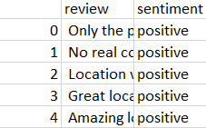
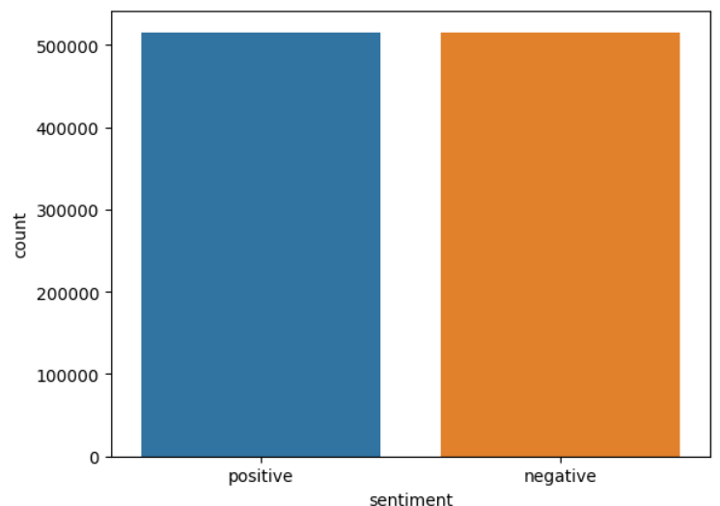

Data
Binary sentiment: 2. Balanced:

Slide 7
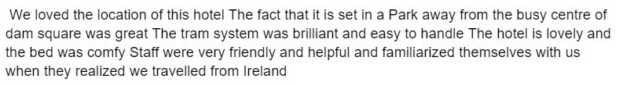
Experiment Setup:
Data Processing:
Before:
After:

Slide 8
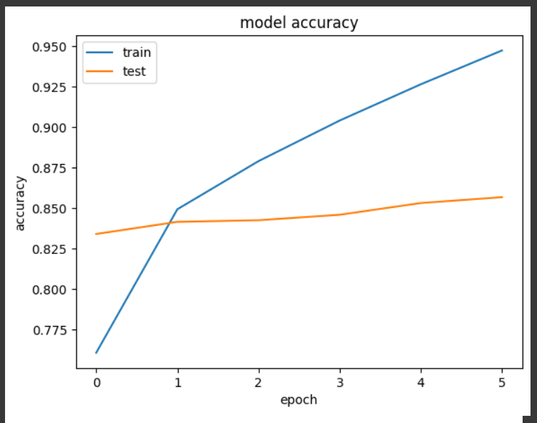
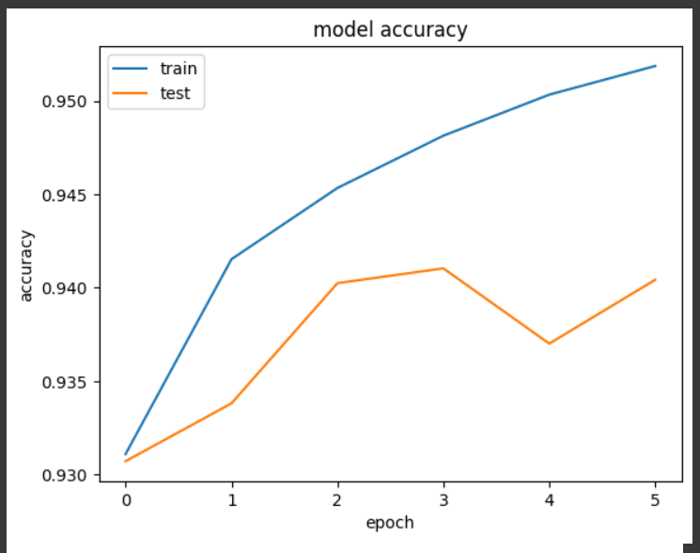
Experiment Setup:
CNN:
6 epoch, 128 batch size
For IMDB Movie dataset:
Test Accuracy: 0.8515999913215637
For Hotel Review dataset:
Test Accuracy: 0.9410167932510376

Slide 9
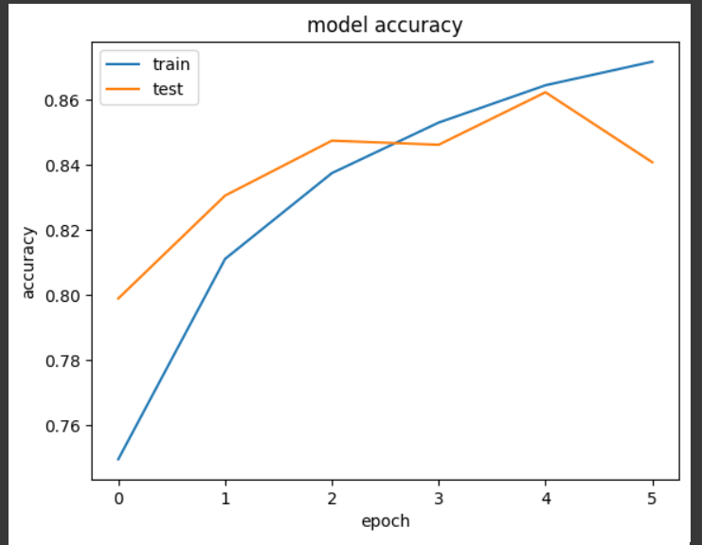
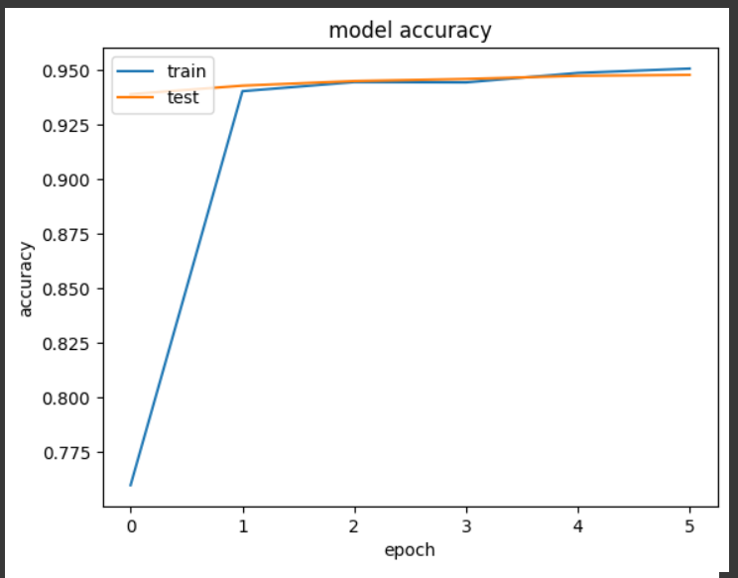
Experiment Setup
RNN:
6 epoch, 128 batch size
For Movie Review dataset:
Test Accuracy: 0.8495000004768372
For Hotel Review dataset:
Test Accuracy: 0.9480794668197632

Slide 10
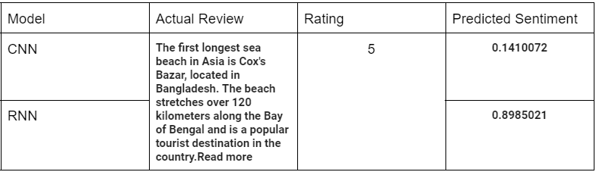
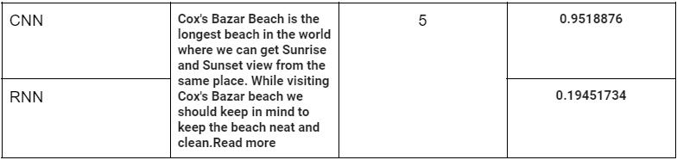
Comparing Results:

Slide 11
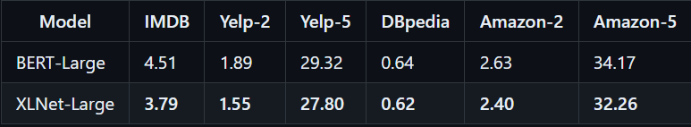
Transformer: XLNet
XLNet outperforms BERT in 20 tasks in 2019 (Yang et al., 2019).
The above numbers are error rates

Slide 12
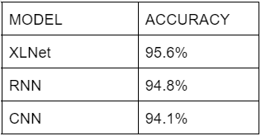
Comparison of XLNet, CNN and RNN
These accuracies are based on the 1st Dataset
For same dataset the training time: XLNet > RNN > CNN

Slide 13
Conclusion
For small dataset CNN will be a better choice for comparable results and faster execution
The models actually works better if trained and tested in relative datasets
For larger dataset XLNet will be better. However, the fine-tuning process will take moderate amount of time

Slide 14
Limitations:
The comparison between the deep learning models were made on only short dataset
Despite better accuracies, few classifications were incorrect for each models, which could be solved by fine-tuning. However, this will require much more time
Many variants of each networks are still unexplored

Slide 15
Future work
Expanding dataset size for better understanding of the outcomes
Including more deep learning models along with the updated version of the currently mentioned ones.
Exploring the impact of dataset’s context and platform on models’ efficiency

Slide 16
References:
Kim, Y. (2014, August 25). [1408.5882] Convolutional Neural Networks for Sentence Classification. arXiv. Retrieved December 5, 2023, from https://arxiv.org/abs/1408.5882
Wang, J., Liu, T., Luo, X., & Wang, L. (2018). An LSTM Approach to Short Text Sentiment Classification with Word Embeddings. Retrieved December 5, 2023, from https://aclanthology.org/O18-1021/
Yang, Z., Dai, Z., Yang, Y., Carbonell, J., Ruslan Salakhutdinov, R., & Le, Q. V. (2019, June 19). [1906.08237] XLNet: Generalized Autoregressive Pretraining for Language Understanding. arXiv. Retrieved December 5, 2023, from https://arxiv.org/abs/1906.08237

Slide 17
Dataset:
IMDB Dataset of 50K Movie Reviews. https://www.kaggle.com/datasets/lakshmi25npathi/imdb-dataset-of-50k-movie-reviews
515K Hotel Reviews Data in Europe. https://www.kaggle.com/jiashenliu/515k-hotel-reviews-data-in-europe
Tripadvisor Bangladesh attraction spots reviews. https://drive.google.com/file/d/16tRD77sLtztMetzO-VecMZHEh9EisSut/view?usp=sharing

